Slide 1

Presented By:
Sarika Sanjaysingh Rajput
Pooja Raikar
Mohammed Yaseen Siddiqui
Pranali S. Wadibhasme
Praduman Kumar Pandey
Preetham murthy U.C

Slide 2
Agenda
Introduction
KPIs
Insights
Dashboards
Conclusion

Slide 3
Introduction
HR Analytics dashboard that can help you track and improve your team's performance. It's a web-based tool that lets you access data on various metrics, such as employee engagement, turnover, retention, productivity, and more. You can also customize the dashboard to suit your needs and preferences.

Slide 4
KPIs
Average Attrition rate for all Departments
Average Hourly rate of Male Research Scientist
Attrition rate Vs Monthly income stats
Average working years for each Department
Job Role Vs Work life balance
Attrition rate Vs Year since last promotion relation

Slide 5
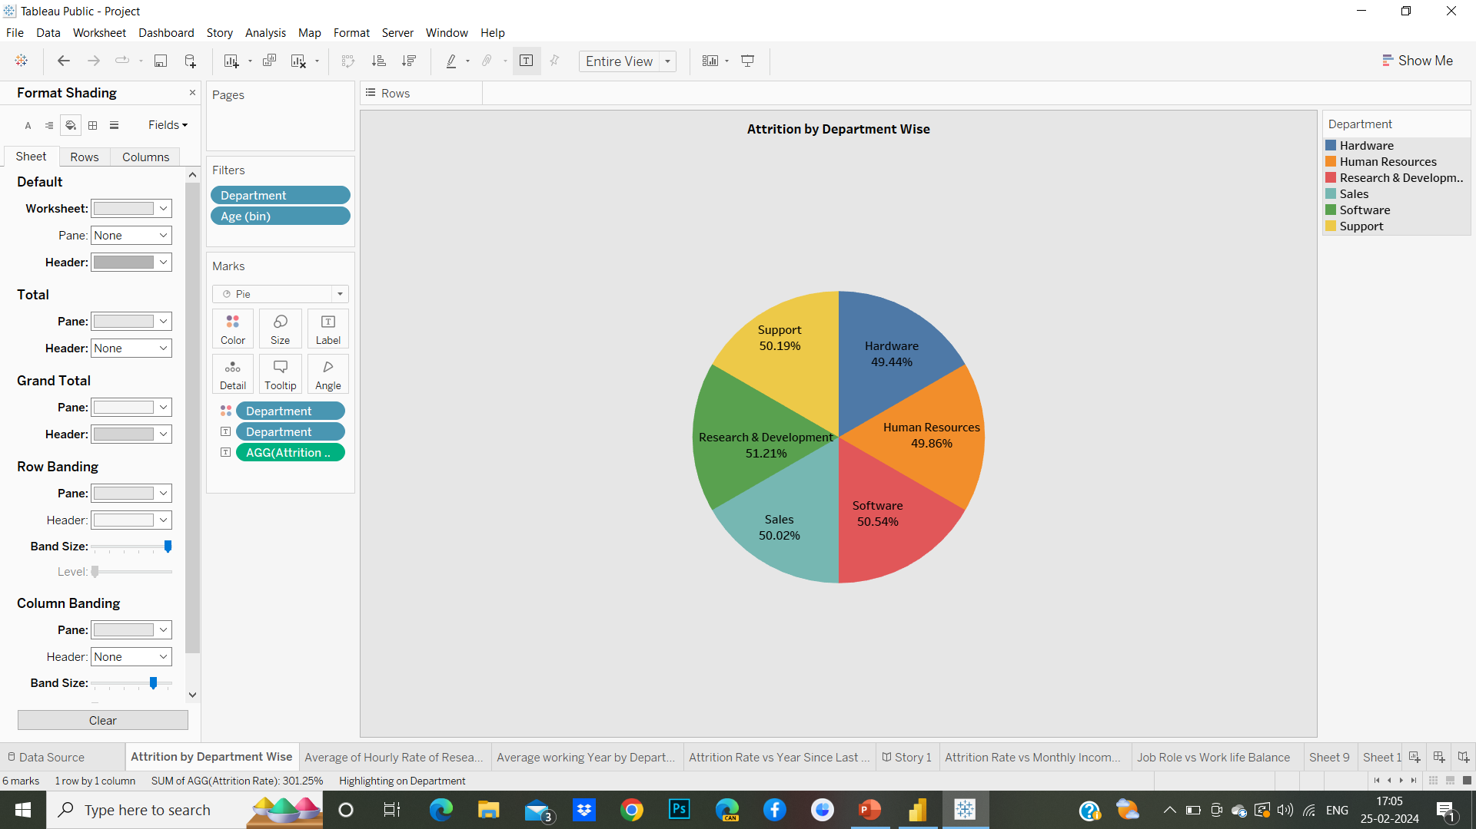
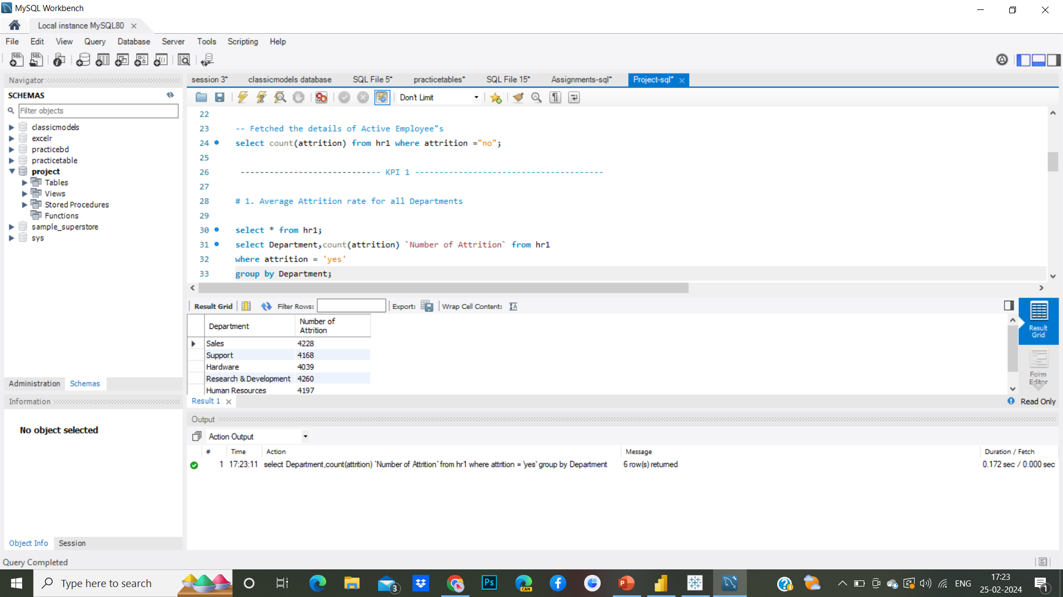
Average Attrition rate for all Departments
This metric provides a comprehensive view of the turnover or departure of employees from various departments within the organization. It essentially indicates the average rate at which employees are leaving their jobs across the entire company, taking into account differences among departments.

Slide 6
Insights
The attrition rate for each department individually and identify which departments have higher-than-average attrition rates. Research and Development can help pinpoint areas of concern that may require further investigation.
Conduct exit interviews with departing employees to gather insights into their reasons for leaving. Analyze this feedback to identify common themes and areas for improvement.
Common factors contributing to attrition include poor management, lack of growth opportunities, low morale, inadequate compensation, and poor work-life balance.
Conduct surveys or interviews with current and former employees to gather feedback on their experiences within the organization.

Slide 7
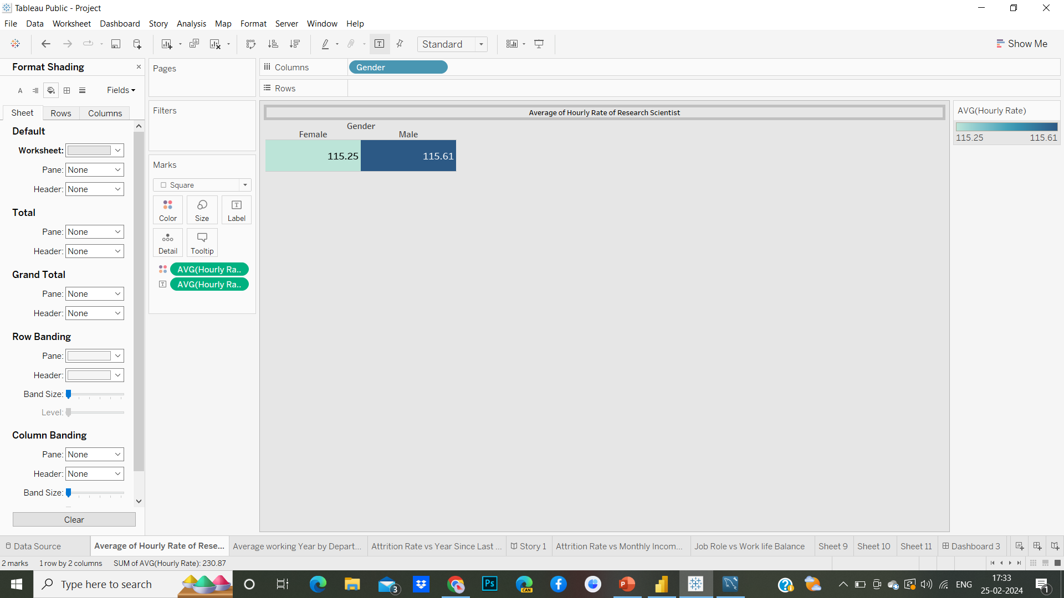
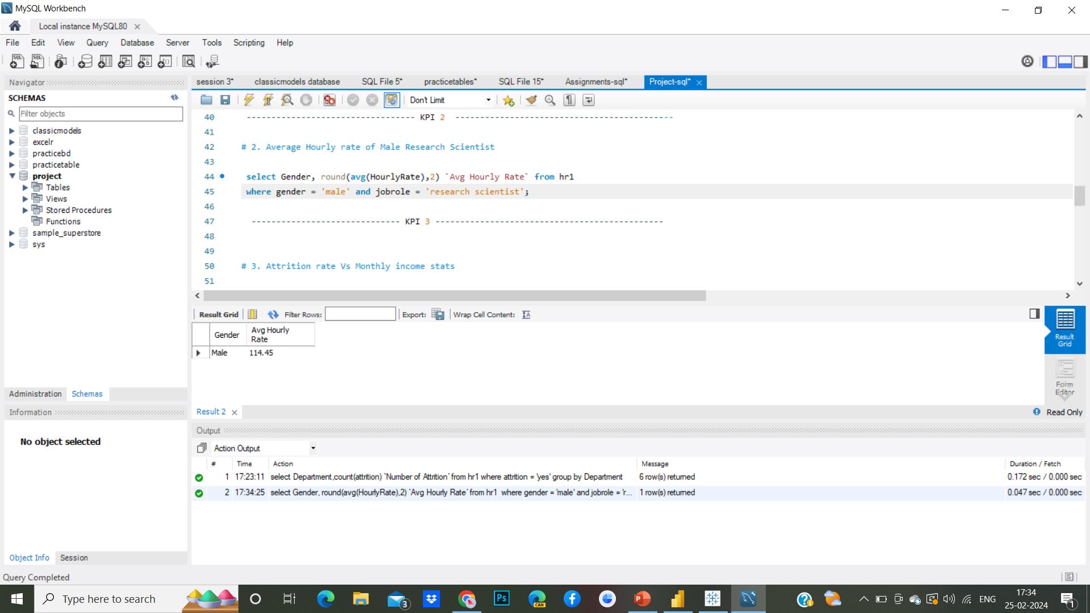
Average Hourly rate of Male Research Scientist
The "Average Hourly Rate of Male Research Scientist" simply refers to the average amount of money earned per hour by men working in the role of a research scientist. This metric helps understand the typical hourly wages for male professionals in this specific occupation.

Slide 8
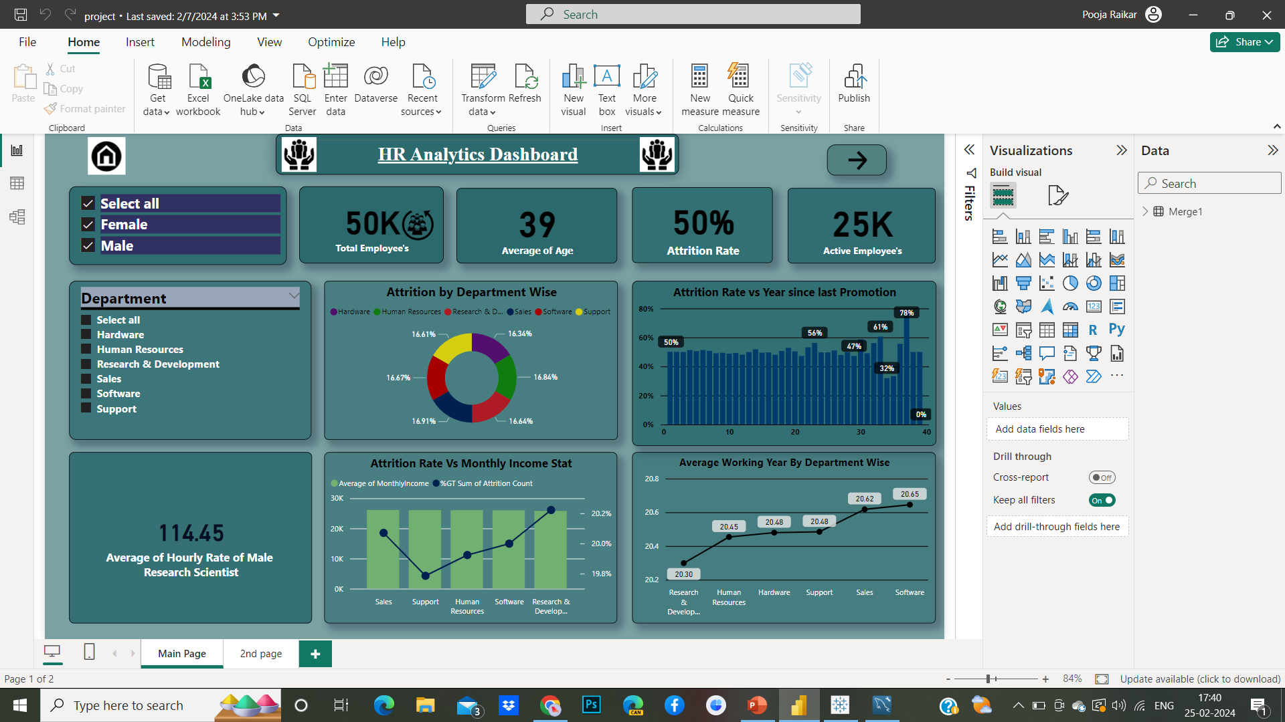
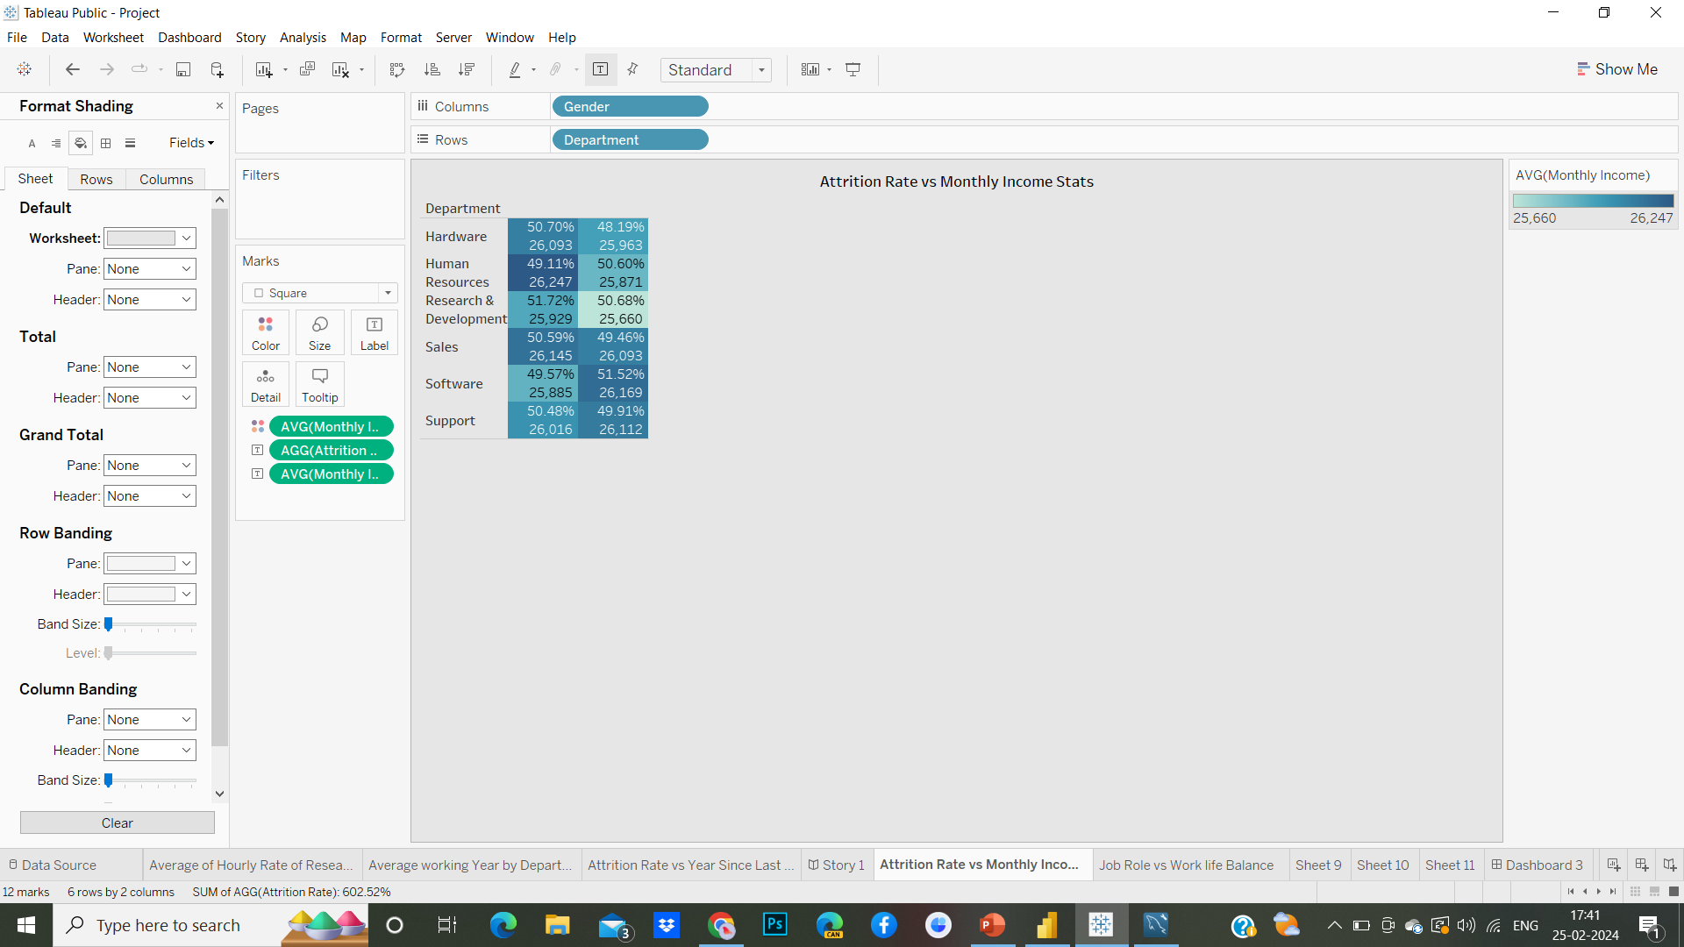
Attrition rate Vs Monthly income stats
"Attrition rate vs. monthly income stats" refers to comparing data on employee turnover or attrition rates with statistics related to monthly income. This analysis aims to explore potential relationships or correlations between the rate at which employees leave an organization (attrition rate) and their monthly income.

Slide 9
Insights
Correlation between Income and Attrition: Determine if there's a correlation between employees' monthly income levels and their likelihood of leaving the organization.
Identifying Income-Attrition Patterns: Look for patterns or trends in attrition rates based on income levels. For instance, certain income brackets might consistently exhibit higher or lower turnover rates.
Addressing Income Disparities: Identify any disparities in income levels among employees and assess their impact on attrition rates. If certain groups with lower incomes are experiencing higher turnover, it may indicate issues related to pay equity, perceived value, or career advancement opportunities.

Slide 10
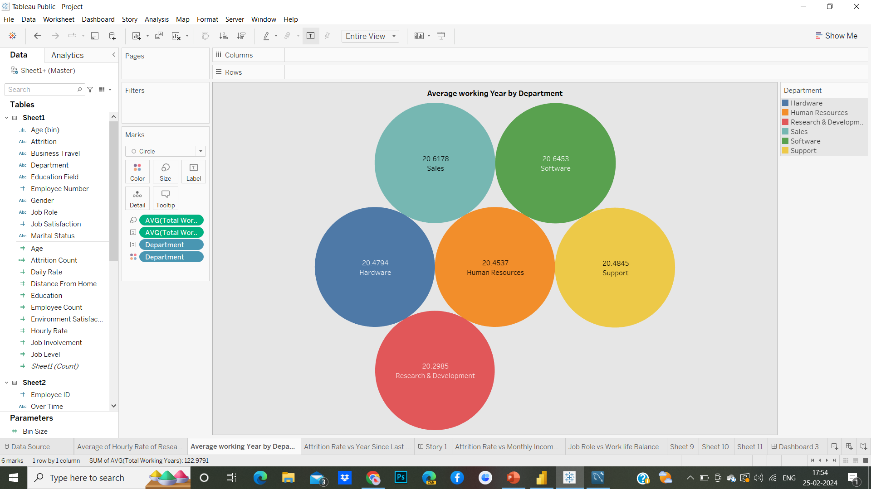
Average working years for each Department
The "Average working years for each Department" refers to the average duration of employment (in years) for employees within each department of an organization. This metric calculates the average length of time that employees have been working in a particular department, providing insights into workforce stability, employee retention, and departmental dynamics.

Slide 11
Insights
A higher average working years for a department generally indicates greater employee retention and stability within that department
Variations in the average working years between departments can reveal differences in departmental cultures, management styles, and opportunities for career growth and development.
Departments with higher average working years may indicate higher levels of employee satisfaction and engagement.
Analyzing the reasons for shorter tenure in these departments can help identify opportunities for improvement in recruitment strategies, employee engagement, and retention efforts.

Slide 12
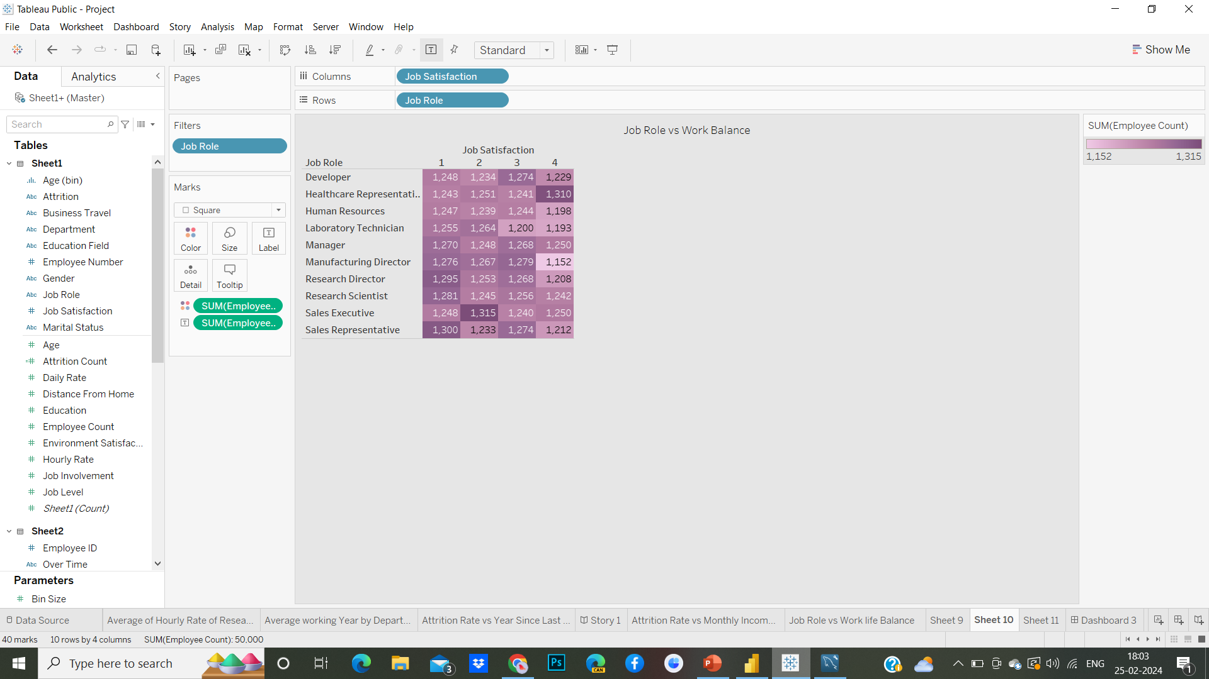
Job Role Vs Work life balance
“Job Role vs. Work-Life Balance" refers to the comparison between the demands and responsibilities associated with a particular job role and the ability of individuals in that role to maintain a healthy balance between their work obligations and personal life.

Slide 13
Insights
Impact of Job Design: Understanding how different job roles affect work-life balance can help organizations design positions that promote employee well-being. For example, roles with flexible hours, remote work options, and manageable workloads may contribute to better work-life balance for employees.
Costs and Benefits: Balancing work and personal life is not only beneficial for employees' well-being but also for organizational success. Investing in work-life balance initiatives may incur costs upfront, but the long-term benefits in terms of employee retention, productivity, and morale can outweigh these costs.
The relationship between job roles and work-life balance enable organizations to create a supportive work environment that promotes employee satisfaction, well-being, and performance while also meeting business objectives.

Slide 14
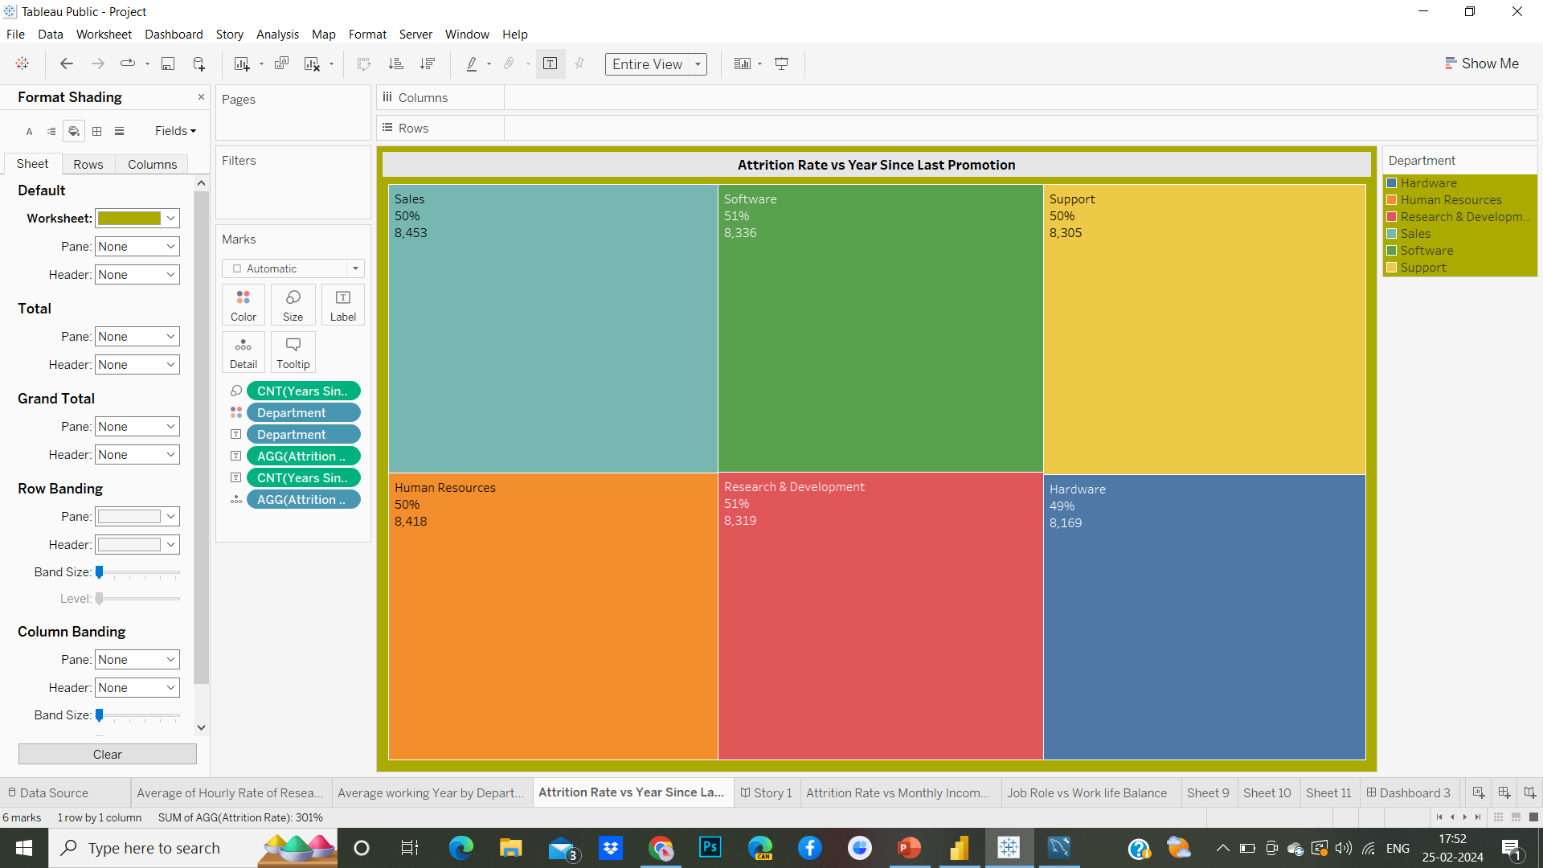
Attrition rate Vs Year since last promotion relation
The "Attrition rate vs. Years since last promotion relation" refers to examining the correlation or relationship between the attrition rate of employees and the number of years since they last received a promotion within an organization. This analysis aims to understand how the frequency of promotions impacts employee retention.

Slide 15
Insights
Longer intervals since the last promotion may contribute to decreased employee engagement and satisfaction, leading to higher attrition rates.
Higher attrition rates among employees who have gone longer periods without a promotion may indicate a correlation between lack of career advancement opportunities and turnover.
Employees often view promotions as recognition of their contributions and opportunities for career growth
The relationship between attrition rate and years since the last promotion provides organizations with actionable insights to optimize their talent management strategies, improve employee engagement and satisfaction, and mitigate the risk of turnover.

Slide 16
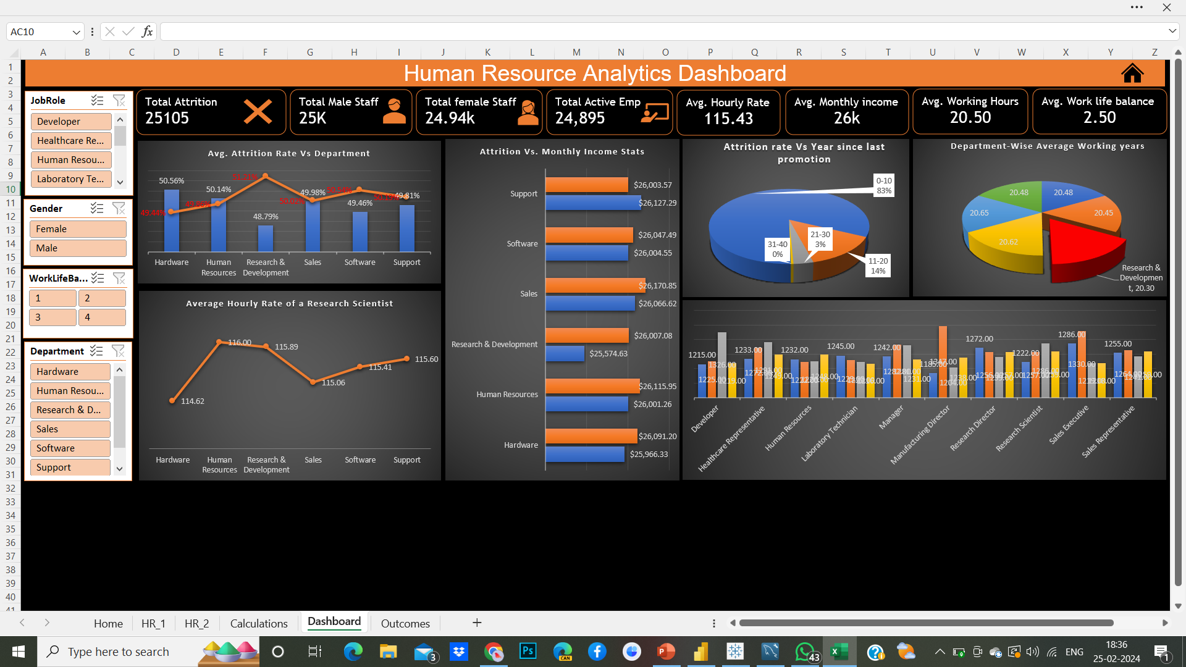
Excel HR Analytics Dashboard

Slide 17
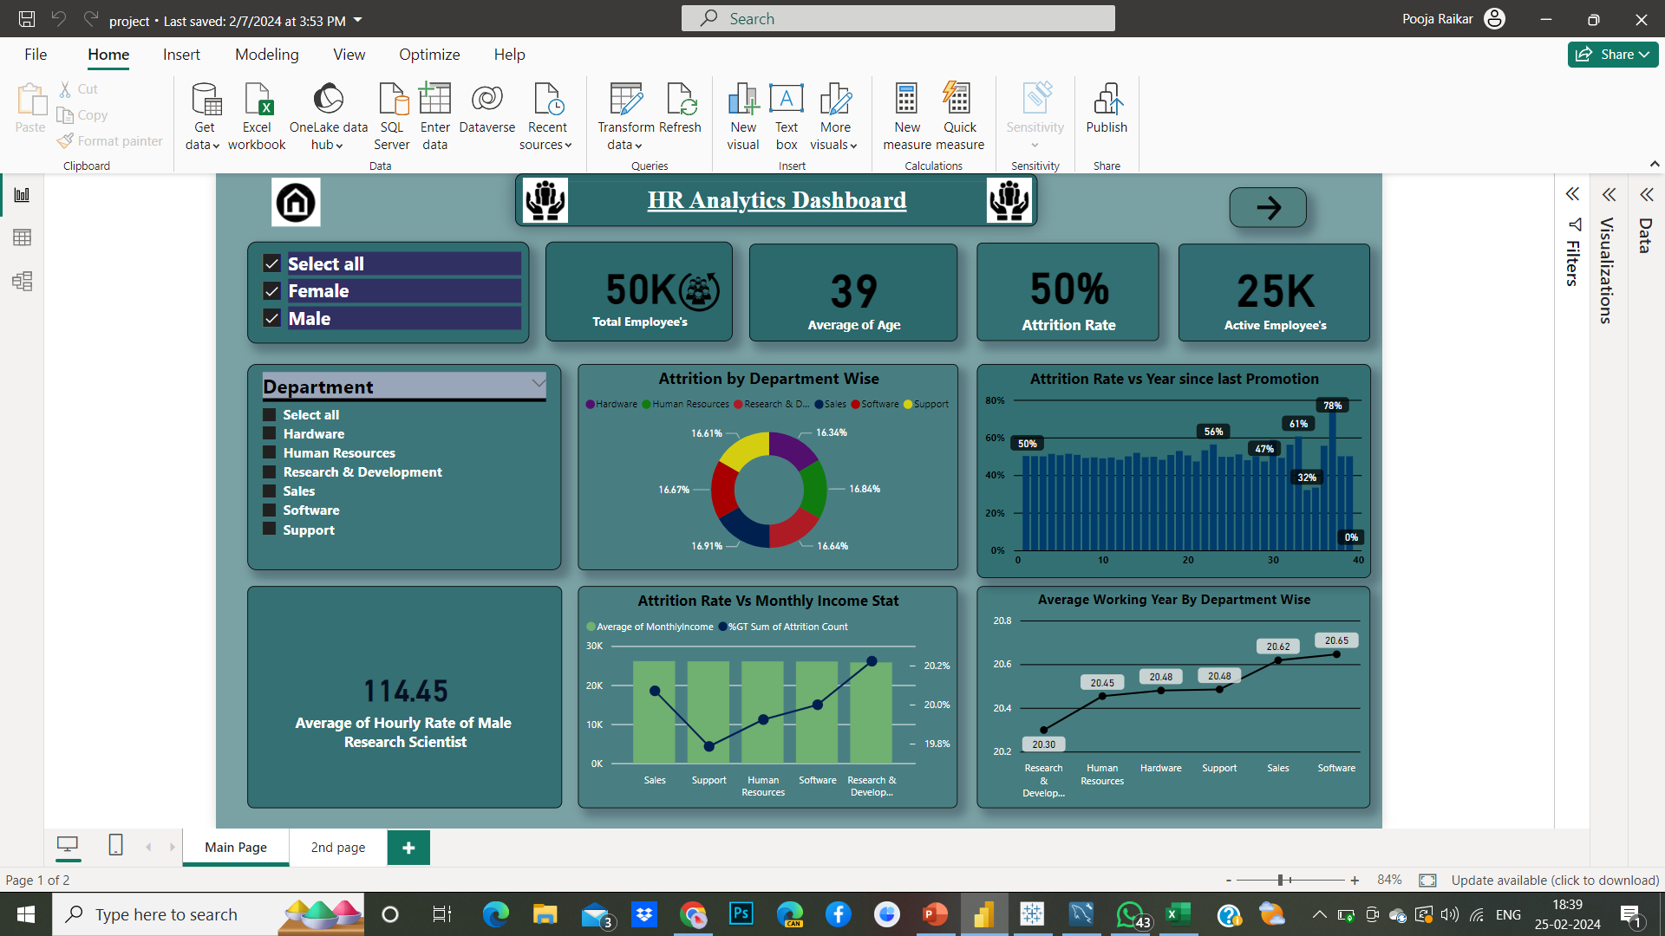
Power BI HR Analytics Dashboard

Slide 18
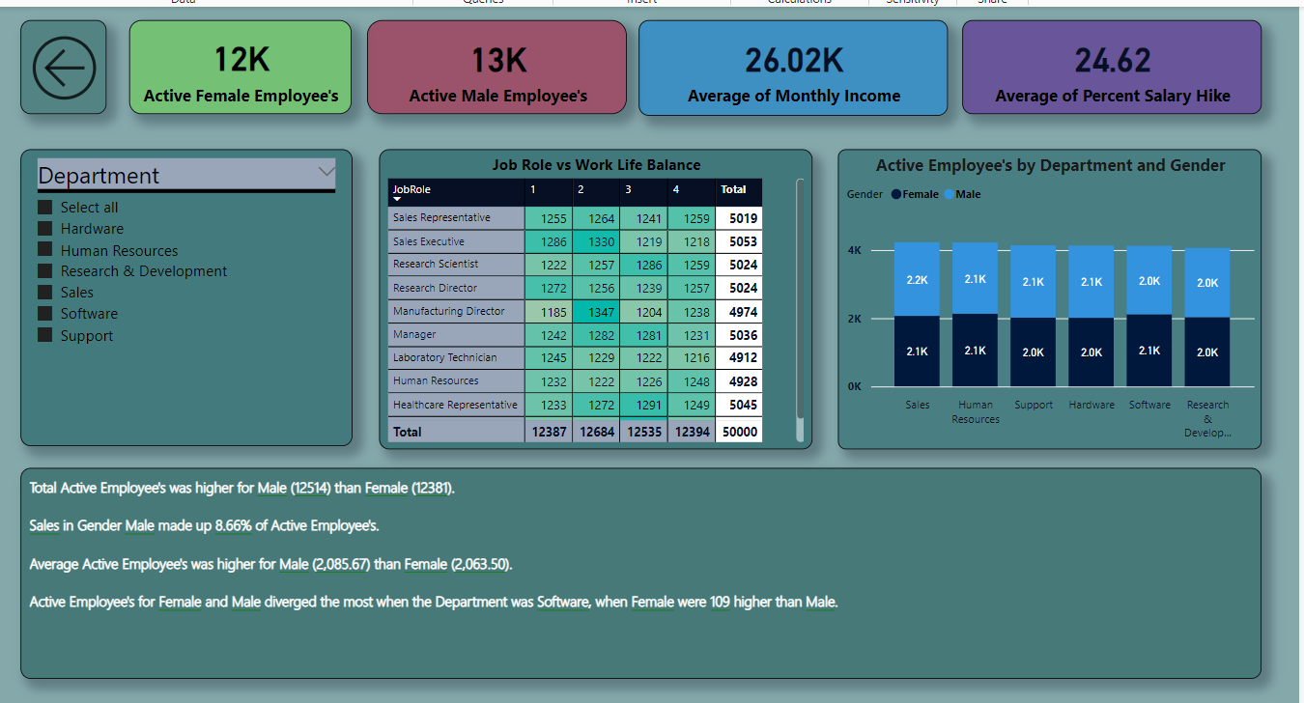

Slide 19
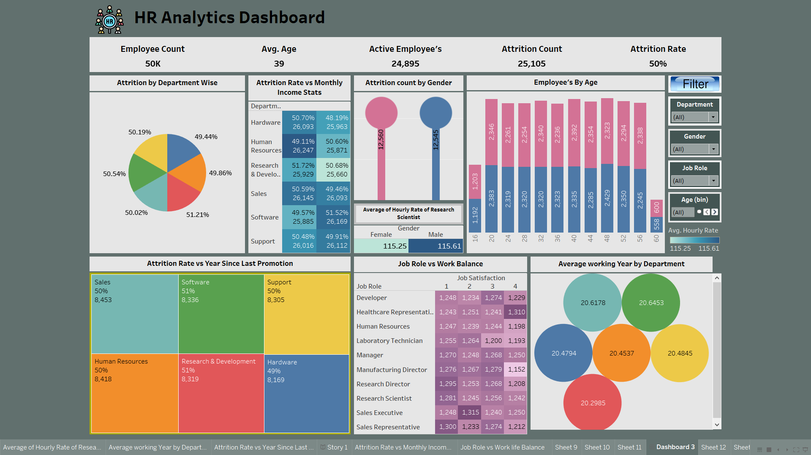
Tableau HR Analytics Dashboard

Slide 20
conclusion
"In conclusion, our analysis of attrition rates has provided valuable insights into our organization's workforce dynamics. We've identified several key trends and factors contributing to attrition, including These insights enable us to better understand the drivers of turnover within our organization and formulate targeted strategies to mitigate attrition and improve employee retention.
Our commitment to data-driven decision-making empowers us to continuously monitor attrition trends, evaluate the effectiveness of our interventions, and adapt our strategies as needed to retain our top talent and drive organizational success.

Slide 21
Thank You

